Slide 1
IT694 Computer Networks Week8-Lec1
Network layer Fundamentals

Slide 2
Network layer: our goals
Principles:
network layer service models
forwarding versus routing
how a router works
addressing
generalized forwarding
IP protocol
NAT

Slide 3
















What services does a Network layer provide?
transport segment from sending to receiving host
sender: encapsulates segments into datagrams, passes to link layer
receiver: delivers segments to transport layer protocol
network layer protocols in every Internet device: hosts, routers
routers:
examines header fields in all IP datagrams passing through it
moves datagrams from input ports to output ports to transfer datagrams along end-end path
mobile network
national or global ISP
application
transport
network
link
physical
network
link
physical
network
link
physical
network
link
physical
network
link
physical
network
link
physical
datacenter
network
application
transport
network
link
physical
enterprise
network

Slide 4
Protocols in the Network layer?

Slide 5
Network service model
Q: What service model for “channel” transporting datagrams from sender to receiver?
example services for individual datagrams:
guaranteed delivery
guaranteed delivery with less than 40 msec delay
example services for a flow of datagrams:
in-order datagram delivery
guaranteed minimum bandwidth to flow
restrictions on changes in inter-packet spacing

Slide 6
Network-layer service model
Quality of Service (QoS) Guarantees ?
Network
Architecture
Internet
ATM
ATM
Internet
Internet
Service
Model
best effort
Constant Bit Rate
Available Bit Rate
Intserv Guaranteed
(RFC 1633)
Diffserv (RFC 2475)
Bandwidth
none
Constant rate
Guaranteed min
yes
possible
Loss
no
yes
no
yes
possibly
Order
no
yes
yes
yes
possibly
Timing
no
yes
no
yes
no
Internet “best effort” service model
No guarantees on:
successful datagram delivery to destination
timing or order of delivery
bandwidth available to end-end flow

Slide 7



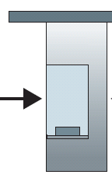

Overview - Router architecture
routing, management
control plane (software)
operates in millisecond
time frame
Station manager
forwarding data plane (hardware) operates in nanosecond timeframe
roundabout
entry stations
exit roads
Notes:
We can easily recognize the principal router components in Figure 4.4 in this analogy—the entry road and entry station correspond to the input port (with a lookup function to determine to local outgoing port); the roundabout corresponds to the switch fabric; and the roundabout exit road corresponds to the output port. With this analogy, it’s instructive to consider where bottlenecks might occur. What happens if cars arrive blazingly fast (for example, the roundabout is in Germany or Italy!) but the station attendant is slow? How fast must the attendant work to ensure there’s no backup on an entry road? Even with a blazingly fast attendant, what happens if cars traverse the roundabout slowly—can backups still occur? And what happens if most of the cars entering at all of the roundabout’s entrance ramps all want to leave the roundabout at the same exit ramp—can backups occur at the exit ramp or elsewhere? How should the roundabout operate if we want to assign priorities to different cars, or block certain cars from entering the roundabout in the first place? These are all analogous to critical questions faced by router and switch designers.

Slide 8
Network layer: data plane, control plane
Data plane:
local, per-router function
determines how datagram arriving on router input port is forwarded to router output port
Control plane
network-wide logic
determines how datagram is routed among routers along end-end path from source host to destination host
values in arriving
packet header
0111
1
3
2

Slide 9

Per-router control plane
Individual routing algorithm components in each and every router interact in the control plane
Routing
Algorithm
control
plane
data
plane
values in arriving
packet header
0111
1
3
2

Slide 10

Router interfaces
223.1.1.1
Q: how are interfaces actually connected?
223.1.2.1
223.1.1.2
A: wired
Ethernet interfaces connected by Ethernet switches
223.1.1.4
223.1.2.9
223.1.1.3
223.1.3.27
223.1.2.2
223.1.3.1
223.1.3.2
A: wireless WiFi interfaces connected by WiFi base station

Slide 11
How Router Forwards Packets

Slide 12
Router architecture overview
high-level view of generic router architecture:
routing, management
control plane (software)
operates in millisecond
time frame
routing
processor
forwarding data plane (hardware) operates in nanosecond timeframe
high-speed
switching
fabric
router input ports
router output ports

Slide 13


Input port functions
lookup,
forwarding
queueing
line
termination
link
layer
protocol
(receive)
switch
fabric
physical layer:
bit-level reception
Datagram
decentralized switching:
using header field values, lookup output port using forwarding table in input port memory (“match plus action”)
goal: complete input port processing at ‘line speed’
input port queuing: if datagrams arrive faster than forwarding rate into switch fabric
link layer:
e.g., Ethernet
(chapter 6)
Frame
Notes:
Green box is a physical layer responsible for receiving bit level transmission. Copper, fiber wireless.
Link layer in blue – bit assemble into Ethernet frame. We will discuss this in details in chapter 6.
But most critical one, is here. Lookup, forwarding function. Lookup and forward is “Match plus action” behavior.
GOAL – processing at “line speed”, otherwise, buffer will be full and packet will be lost

Slide 14
Input port functions
lookup,
forwarding
queueing
line
termination
link
layer
protocol
(receive)
switch
fabric
physical layer:
bit-level reception
decentralized switching:
using header field values, lookup output port using forwarding table in input port memory (“match plus action”)
destination-based forwarding: forward based only on destination IP address (traditional)
generalized forwarding: forward based on any set of header field values
link layer:
e.g., Ethernet
(chapter 6)

Slide 15
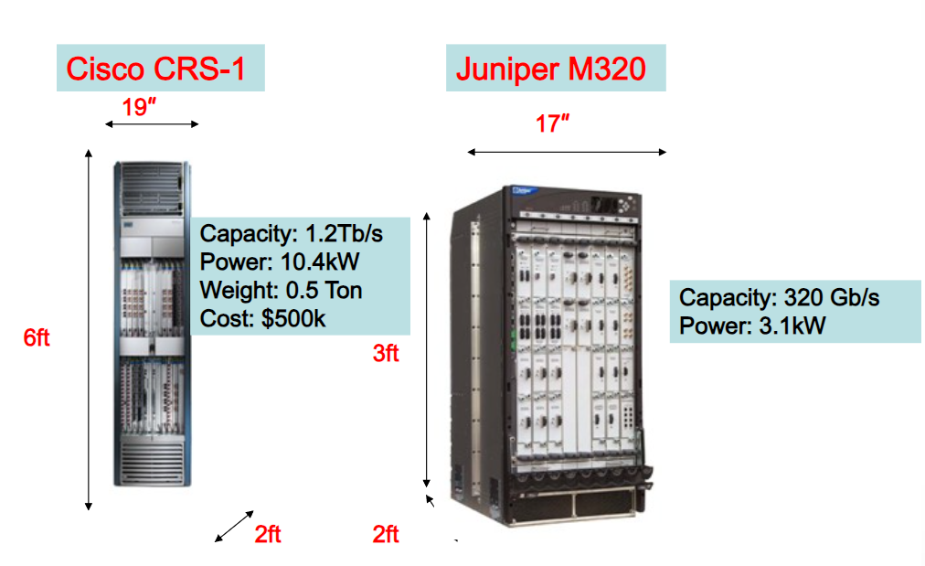
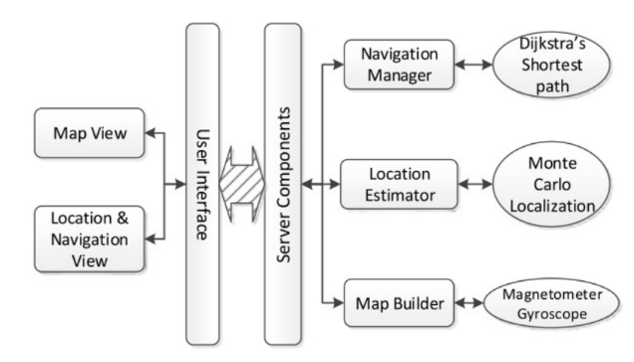
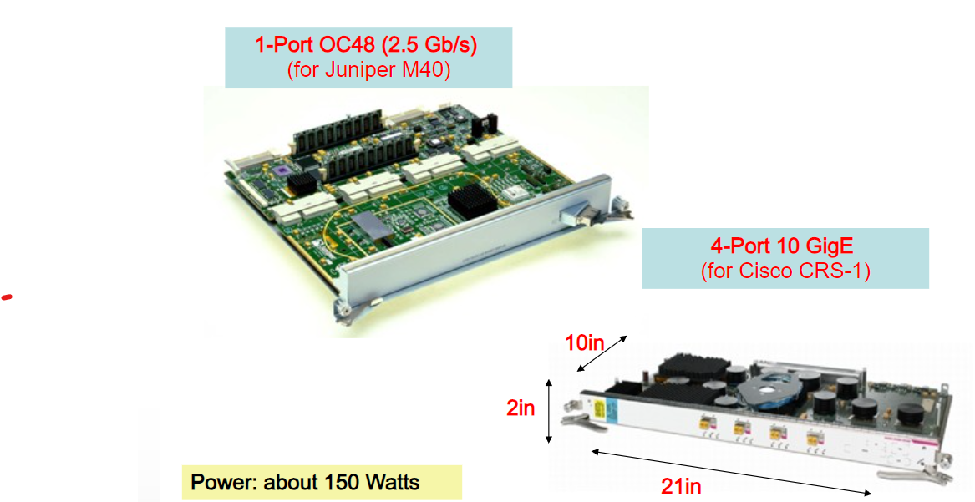

Slide 16
Input port queuing
If switch fabric slower than input ports combined -> queueing may occur at input queues
queueing delay and loss due to input buffer overflow!
Head-of-the-Line (HOL) blocking: queued datagram at front of queue prevents others in queue from moving forward
switch
fabric
switch
fabric
output port contention: only one red datagram can be transferred. lower red packet is blocked
one packet time later: green packet experiences HOL blocking

Slide 17
Output port queuing
datagram
buffer
queueing
switch
fabric
(rate: NR)
link
layer
protocol
(send)
line
termination
R
Buffering required when datagrams arrive from fabric faster than link transmission rate. Drop policy: which datagrams to drop if no free buffers?
Datagrams can be lost due to congestion, lack of buffers
Scheduling discipline chooses among queued datagrams for transmission
Priority scheduling – who gets best performance, network neutrality

Slide 18
Output port queuing
switch
fabric
switch
fabric
at t, packets more
from input to output
one packet time later
buffering when arrival rate via switch exceeds output line speed
queueing (delay) and loss due to output port buffer overflow!

